Slide 1
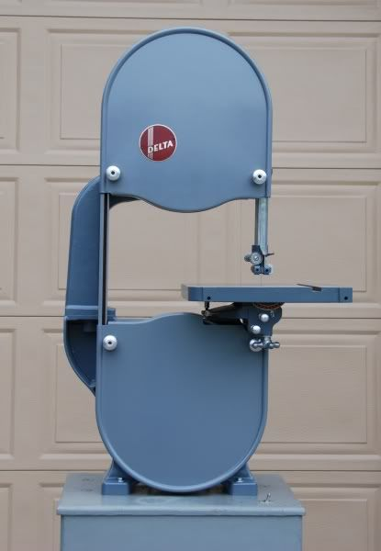
The Bandsaw
The Bandsaw is one of the most versatile of all woodworking machines (and it can cut metals and plastics too).
It can perform Rip (with the grain) cutting, Cross cutting (across the grain), curve cutting, Jig sawing, and circle cutting
It is the best tool for Re-sawing timber for producing veneers and book-matched wood for doors, boxes etc.
It can cut various joints (e.g. tenons for mortise and tenons) and even dovetails.
It can be used as a mini Sawmill for producing your own timber from small (ish) logs.
It is an essential tool for the woodturner for producing blanks for turning (and not onlt for bowls)

Slide 2
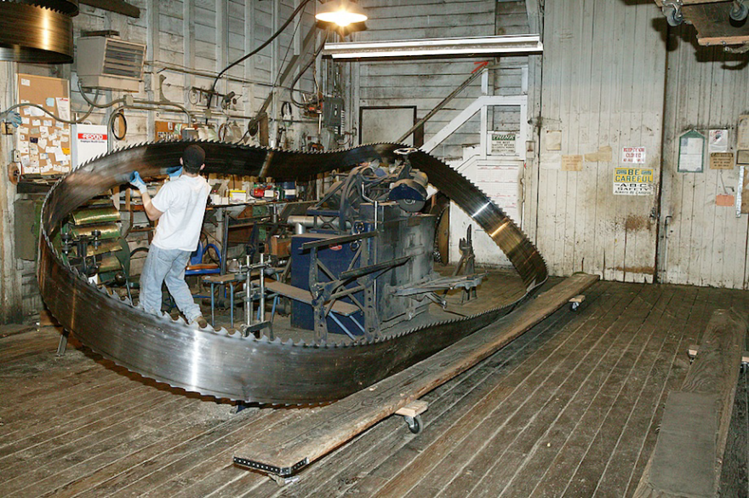
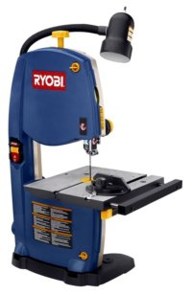
The bandsaw comes in different sizes…from hobbyist to industrial…

Slide 3
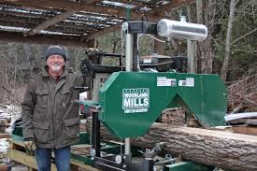
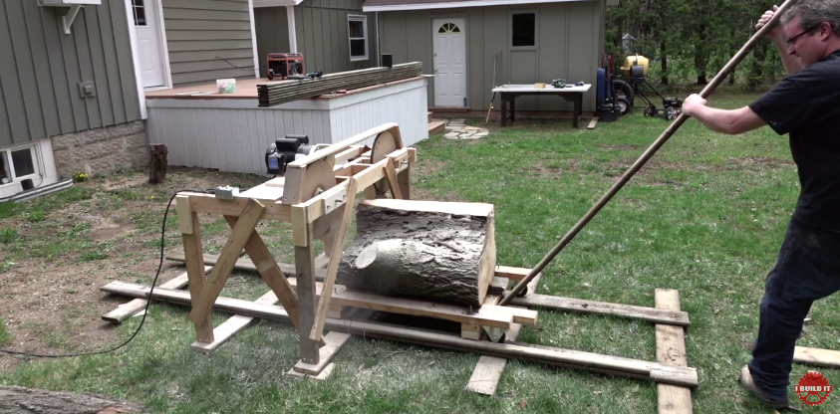
And everything in between
Michael Fortune (well known Canadian furniture maker) and his new bandsaw mill.
John Heiz (Canadian woodwork blogger) with his homemade bandmill that he seems wary of approaching too closely (http://www.ibuildit.ca/)

Slide 4
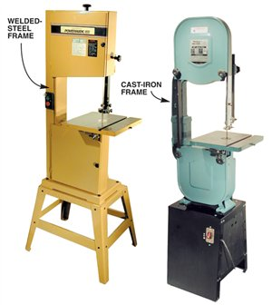
The Bandsaw: Two Basic Types

Slide 5
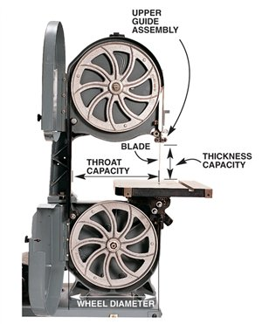

Slide 6
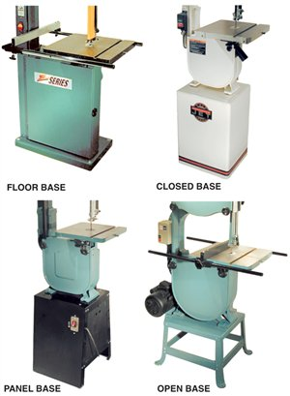

Slide 7
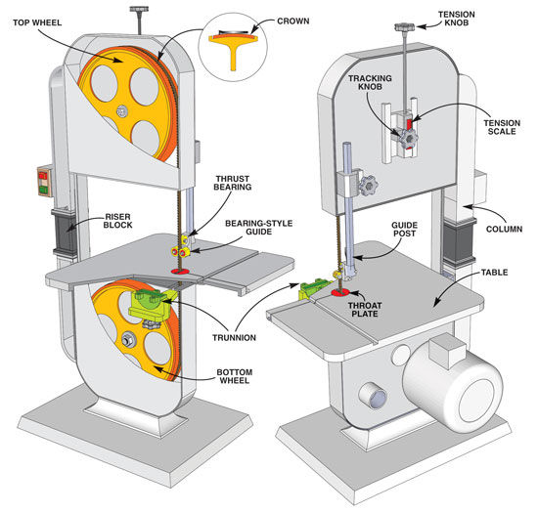

Slide 8
What to look for in buying a bandsaw
Capacity
  Throat: distance from blade to stand (How wide do you need to cut? )
  Depth: How deep a cut do you need to do? ( important for turners and resawers)
Frame
  Cast Iron Frame (early and later Delta-type saws). Capable of having Riser Block added
  Welded Steel Frame. Better at absorbing vibration under load if well made.
Base
  Floor mounted (large wheel types) or Enclosed bases
  Open stand or flimsy cabinet or bench mounted. Need to add weight, prevent vibration
Motor
  ½ hp (.375kW) for hobbyist use (thin material such as ply, mdf etc)
  ¾ hp (.56kW) is OK for 'most' general woodworking
  1hp (.75kW recommended for thicker stock (50mm+) and Resawing
Guides
  Rear Thrust guide: is it a bearing and is it working freely. How easy to adjust?
  Blade guides: How easy to adjust? Cool blocks or solid metal or bearings
  Rigidity, accuracy and ease of adjustment is of prime importance.
  Does the adjustable sliding guide post retain its settings as it is moved up and down?
Table and fence
  Cast iron? Flat? Easy to adjust for level and right angles to blade?
  Tilt mechanism accurate
  Rip fence adjustable
  Quality of mitre gauge?
Switches, knobs, covers, guards
  Positioning of on/off; position of tensioning knob; Hinged doors? Blade guarded?
Dust collection
  Is the port big enough and in the right place?

Slide 9
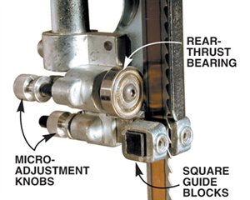
Block-style blade guides with ball bearing rear thrust bearing

Slide 10
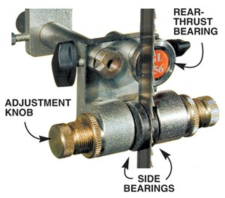
'Euro-style' blade guides

Slide 11
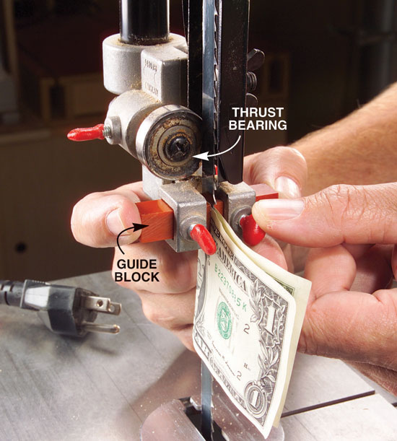
The American way of adjusting blade guide blocks!
A frequently recommended setting is 1/64th of an inch or 0.4mm for this space as well as the spacing behind the thrust bearing. 80gm photocopy paper is 0.1mm thick.

Slide 12
References
Books
  Mark Duginske (1989) Bandsaw Handbook. Sterling: New York.
  Getting the most out of your Band Saw & Scroll Saw (1954). Deltacraft Manual: Pittsburgh.
Articles
  Tom Begnall and John White (2001). 14-inch Bandsaws Reviewed. Fine Woodworking Tools and Shops ed. 2001.
  Vaughan, Robert (1997). Fine-Tuning a Bandsaw. Fine Woodworking May/June 1997.
  White, John (2002) Bandsaw Tune-up. Fine Woodworking July/August 2002.
Videos
  http://www.finewoodworking.com/2011/04/07/how-to-set-up-a-bandsaw
  https://www.youtube.com/watch?v=wGbZqWac0jU
  https://www.youtube.com/watch?v=MBbFBf5t0Kk
  https://www.youtube.com/watch?v=cQqq3rAZ4PI
  https://www.youtube.com/watch?v=rwu7GvJ76qU

